Slide 1


Software Engineering Fundamentals
http://academy.telerik.com
Software Development Practices and Methodologies
Telerik Software Academy
Learning & Development
http://academy.telerik.com

Slide 2

Table of Contents
Software engineering overview
Requirements
Design
Construction
Testing
Project management
Development methodologies overview
The waterfall development process
Heavyweight methodologies
Agile methodologies, SCRUM and XP

Slide 3

Software Engineering
Requirements, Design, Construction, Testing

Slide 4


What is Software Engineering?
Software engineering is the application of a systematic, disciplined, quantifiable approach to the development, operation, and maintenance of software.
Definition by IEEE

Slide 5

Software Engineering
Software engineering is:
An engineering discipline that provides knowledge, tools, and methods for:
Defining software requirements
Performing software design
Software construction
Software testing
Software maintenance tasks
Software project management

Slide 6
Software Development Activities
Software development always includes the following activities (to some extent):
Requirements analysis
Design
Construction
Testing (sometimes)
These activities do not follow strictly one after another (depends on the methodology)!
Often overlap and interact
Software Project Management

Slide 7

Software Requirements
Functional & Non-functional Requirements, SRS, User Story Cards

Slide 8

Software Requirements
Software requirements define the functionality of the system
Answer the question "what?", not "how?"
Define constraints on the system
Two kinds of requirements
Functional requirements
Non-functional requirements

Slide 9
Requirements Analysis
Requirements analysis starts from a vision about the system
Customers don't know what they need!
Requirements come roughly and are specified and extended iteratively
The outcome is the Software Requirements Specification (SRS) or set of User Stories
Prototyping is often used, especially for the user interface (UI)

Slide 10

Software Requirements Specification (SRS)
The Software Requirements Specification (SRS) is a formal requirements document
It describes in details:
Functional requirements
Business processes
Actors and use-cases
Non-functional requirements
E.g. performance, scalability, constraints, etc.

Slide 11
Agile Requirements and User Stories
Requirements specifications are too heavy
Does not work well in dynamic projects that change their requirements every day
Agile development needs agile requirements
Split into small iterations
How to split the requirements?
Use simple, informal requirements description
User story: a small feature that brings some value to the end-user

Slide 12
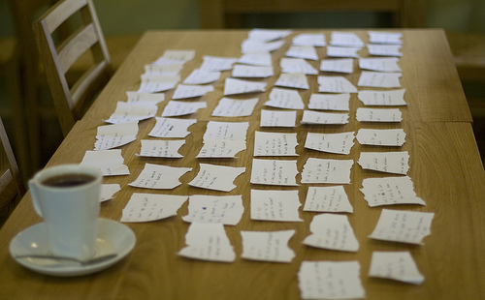
What is User Story?
User story
User needs to accomplish something
Written informal (in words / images / sketches)
Looks like use-case but is different (less formal)
User stories have
Actor (who?)
Goal (what?, why?)
Other info
Owner, estimate, …

Slide 13
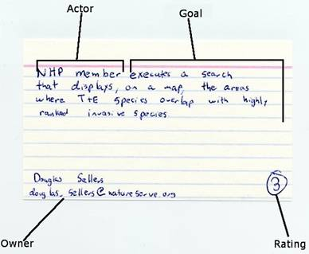
User Story – Example

Slide 14
Software Requirements
It is always hard to describe and document the requirements in comprehensive way
Good requirements save time and money
Requirements always change during the project!
Good requirements reduces the changes
Prototypes significantly reduce changes
Agile methodologies are flexible to changes
Incremental development in small iterations

Slide 15

Software Requirements Specifications (SRS), User Stories and UI Prototypes
Live Demo

Slide 16
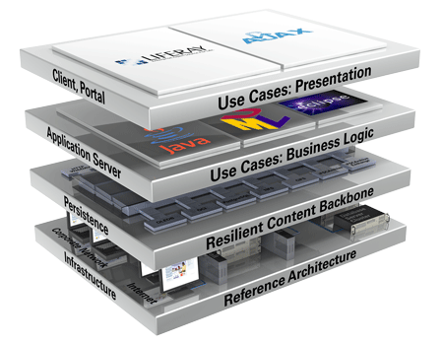
Software Architecture and Software Design

Slide 17

Software Architecture and Software Design
Software design is a technical description (blueprints) about how the system will implement the requirements
The system architecture describes:
How the system will be decomposed into subsystems (modules)
Responsibilities of each module
Interaction between the modules
Platforms and technologies

Slide 18
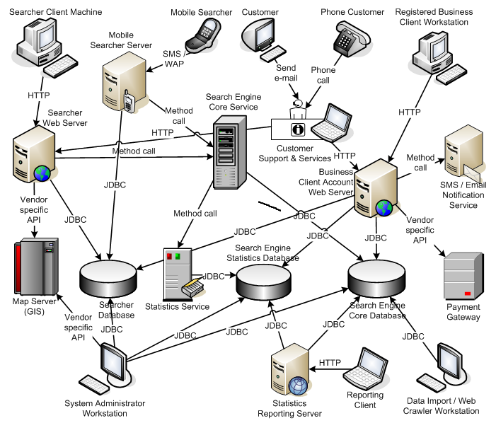
System Architecture Diagram – Example

Slide 19
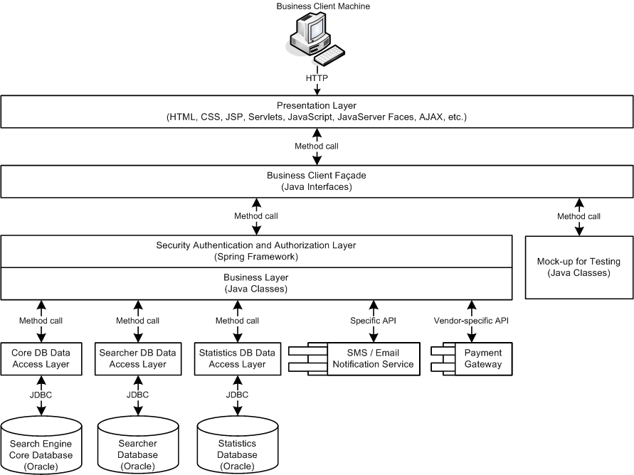
Software Architecture Diagram – Example

Slide 20
Software Design
Detailed Design
Describes the internal module structure
Interfaces, data design, process design
Object-Oriented Design
Describes the classes, their responsibilities, relationships, dependencies, and interactions
Internal Class Design
Methods, responsibilities, algorithms and interactions between them

Slide 21

Software Design Document (SDD)
The Software Design Document (SDD)
Formal description of the architecture and design of the system
It contains:
Architectural design
Modules and their interaction (diagram)
For each module
Process design (diagrams)
Data design (E/R diagram)
Interfaces design (class diagram)

Slide 22

Software Design Document
Live Demo

Slide 23

Software Construction
Implementation, Unit Testing, Debugging, Integration

Slide 24

Software Construction
During the software construction phase developers create the software
Sometimes called implementation phase
It includes:
Internal method design
Writing the source code
Writing unit tests (optionally)
Testing and debugging
Integration

Slide 25

Writing the Code
Coding is the process of writing the programming code (the source code)
The code strictly follows the design
Developers perform internal method design as part of coding
The source code is the output of the software construction process
Written by developers
Can include unit tests

Slide 26

Testing the Code
Testing checks whether the developed software conforms to the requirements
Aims to identify defects (bugs)
Developers test the code after writing it
At least run it to see the results
Unit testing works better
Units tests can be repeated many times
System testing is done by the QA engineers
Unit testing is done by developers

Slide 27
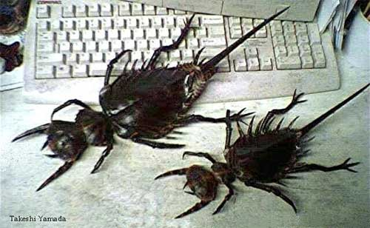
Debugging
Debugging aims to find the source of already identified defect and to fix it
Performed by developers
Steps in debugging:
Find the defect in the code
Identify the source of the problem
Identify the exact place in the code causing it
Fix the defect
Test to check if the fix is working correctly

Slide 28

Integration
Integration is putting all pieces together
Compile, run and deploy the modules as a single system
Test to identify defects
Integration strategies
Big bang, top-down and bottom-up
Continuous integration

Slide 29
Coding != Software Engineering
Inexperienced developers consider coding the core of development
In most projects coding is only 20% of the project activities!
The important decisions are taken during the requirements analysis and design
Documentation, testing, integration, maintenance, etc. are often disparaged
Software engineering is not just coding!
Programmer != software engineer

Slide 30
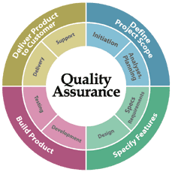
Software Verification and Testing

Slide 31

Software Verification
What is software verification?
It checks whether the developed software conforms to the requirements
Performed by the Software Quality Assurance Engineers (QA engineers)
Two approaches:
Formal reviews and inspections
Different kinds of testing
Cannot certify absence of defects!
Can only decrease their rates

Slide 32
Software Testing
Testing checks whether the developed software conforms to the requirements
Testing aims to find defects (bugs)
Black-box and white-box tests
Unit tests, integration tests, system tests, acceptance tests
Stress tests, load tests, regression tests
Tester engineers can use automated test tools to record and execute tests

Slide 33

Software Testing Process
Test planning
Establish test strategy and test plan
During requirements and design phases
Test development
Test procedures, test scenarios, test cases, test scripts
Test execution
Test reporting
Retesting the defects

Slide 34
Test Plan and Test Cases
The test plan is a formal document that describes how tests will be performed
List of test activities to be performed to ensure meeting the requirements
Features to be tested, testing approach, schedule, acceptance criteria
Test scenarios and test cases
Test scenarios – stories to be tested
Test cases – tests of single function

Slide 35


Test Plans and Test Cases
Live Demo

Slide 36

Software Project Management

Slide 37
What is Project Management?
Project management is the discipline of organizing and managing work and resources in order to successfully complete a project
Successfully means within defined scope, quality, time and cost constraints
Project constraints:
Scope
Quality
Cost
Time

Slide 38
What is Software Project Management?
Software project management
Management discipline about planning, monitoring and controlling software projects
Project planning
Identify the scope, estimate the work involved, and create a project schedule
Project monitoring and control
Keep the team up to date on the project's progress and handle problems

Slide 39
What is Project Plan?
The project plan is a document that describes how the work on the project will be organized
Contains tasks, resources, schedule, milestones, etc.
Tasks have start, end, assigned resources (team members), % complete, dependencies, nested tasks, cost, etc.
Project management tools simplify creating and monitoring project plans

Slide 40
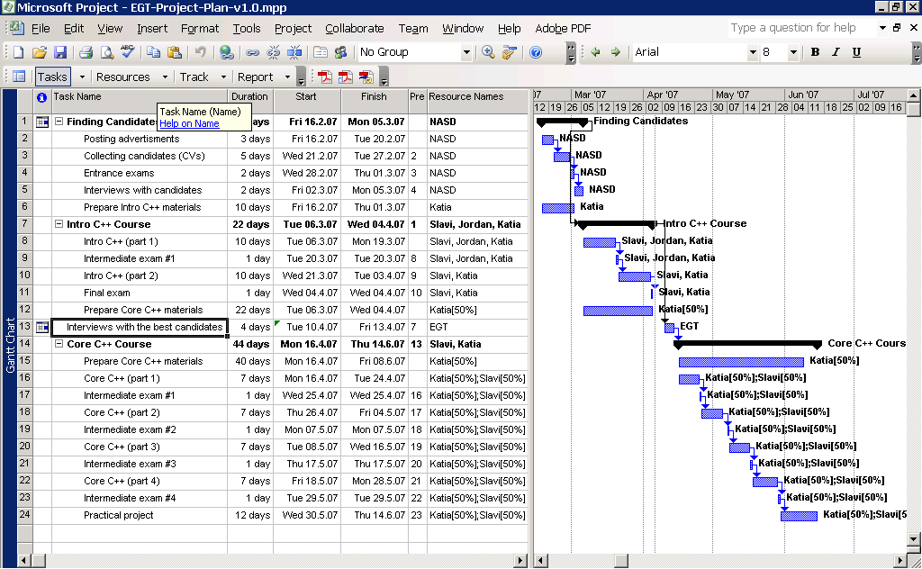
Project Plan – Example

Slide 41

Development Methodologies
Waterfall, Scrum, Lean Development, Kanban, Extreme Programming

Slide 42
What is a Development Methodology?
A development methodology is a set of practices and procedures for organizing the software development process
A set of rules that developers have to follow
A set of conventions the organization decides to follow
A systematical, engineering approach for organizing and managing software projects

Slide 43
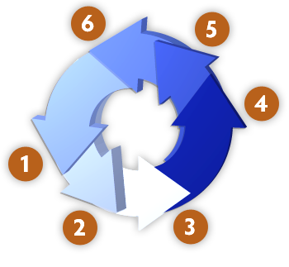
Development Methodologies
Back in history
The "Waterfall" Process
Old-fashioned, not used today
Rational Unified Process (RUP)
Microsoft Solutions Framework (MSF)
Modern development methodologies
Agile development processes
Scrum, Kanban, Lean Development, Extreme Programming (XP), etc.

Slide 44



The Waterfall Development Process

Slide 45
The Waterfall Process
The waterfall development process:
Software
Requirements
Software
Design
Implementation
(Coding)
Verification
(Testing)
Operation
(Maintenance)
Notes:
It’s only in testing that your design is tested against reality. At this point you always learn something about your design (usually that it is wrong!), and that tells you something about your requirements (ditto!)

Slide 46
Formal Methodologies
Formal methodologies are heavyweight!
Requirements
Full of documents,
diagrams, etc.
System
Requirements
Design
Analysis
Software
Requirements
Detailed
Design
Preliminary
Design
Coding
Software
Requirements
Specification
Integration
Analysis
Testing
Prelim.
Review
Program
Design
Usage
Preliminary
Design
Document
Operating
Instructions
Design Review
Coding
Testing
Code Review
Test
Plan
UI Design Document
Final
Design
Operations

Slide 47

Agile Development

Slide 48

The Agile Manifesto
“Our highest priority is to satisfy the
customer through early and continuous
delivery of valuable software“
Manifesto for Agile

Slide 49

The Agile Spirit
Incremental
Working software over comprehensive documentation
Cooperation
Customer collaboration over contract negotiation
Straightforward
Individuals and interactions over processes and tools
Adaptive
Responding to change over following a plan

Slide 50

Agile Methodologies
Scrum
Kanban
Lean Software Development
eXtreme Programming (XP)
Feature-Driven Development (FDD)
Crystal family of methodologies
Adaptive Software Development (ASD)
Dynamic System Development Model (DSDM)
Agile Unified Process (AUP)

Slide 51
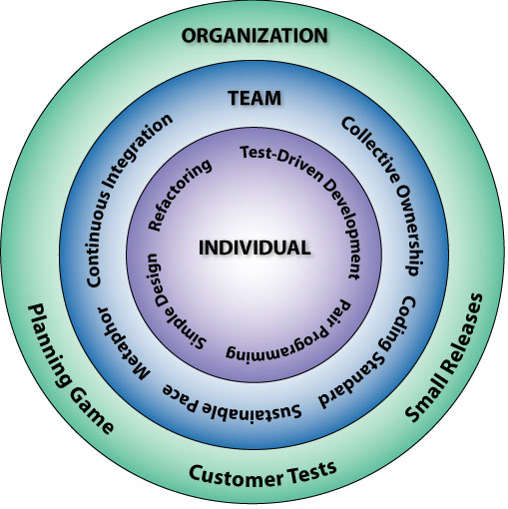
Extreme Programming: The 12 Key Practices
The Planning Game
Small Releases
Metaphor
Simple Design
Test-Driven Development
Refactoring
Pair Programming
Collective Ownership
Continuous Integration
40-Hour Workweek
On-site Customer
Coding Standards

Slide 52

Scrum
Scrum is an iterative incremental framework for managing complex projects
Scrum roles:
Scrum Master – maintains the Scrum processes
Product Owner – represents the stakeholders
Team – a group of about 7 people
The team does the actual development: analysis, design, implementation, testing, etc.

Slide 53
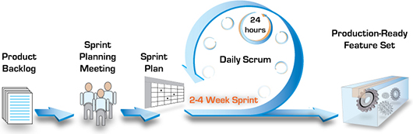
Scrum Terminology
Sprint
An iteration in the Scrum development
Usually few weeks
Product Backlog
All features that have to be developed
Sprint Backlog
All features planned for the current sprint

Slide 54
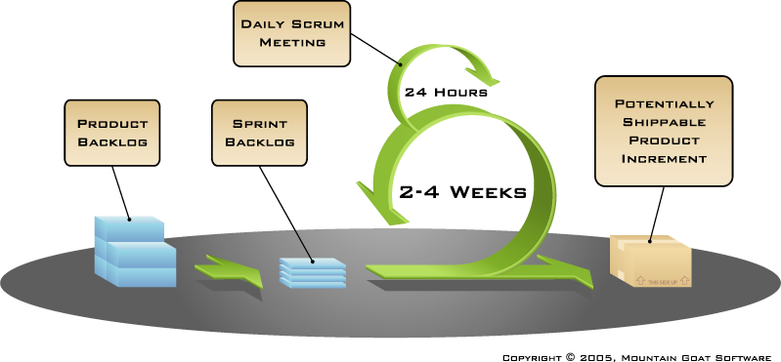
The Scrum Process Framework

Slide 55
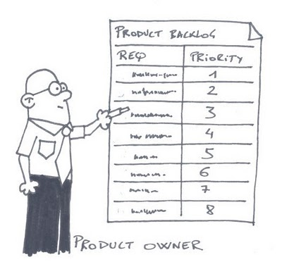
Scrum Practices
Sprint Planning Meeting
At the beginning of the sprint cycle
Establish the Sprint backlog
Daily Scrum stand-up meeting
Each day during the sprint – project status from each team member
Timeboxed to 15 minutes
Sprint Review Meeting
Review the work completed / not completed

Slide 56
Software Engineering Fundamentals
http://academy.telerik.com

Slide 57




Free Trainings @ Telerik Academy
C# Programming @ Telerik Academy
csharpfundamentals.telerik.com
Telerik Software Academy
academy.telerik.com
Telerik Academy @ Facebook
facebook.com/TelerikAcademy
Telerik Software Academy Forums
forums.academy.telerik.com

